Slide 1
THE ETCH PROCESS
Top Down Manufacturing

Slide 2
Purpose of Etch
To remove material from areas identified by the lithography process
  Areas of photoresist exposed to light Developing leaves only these areas open
  Etching removes substrate areas not masked
To create structures for functional use
To remove oxide layers below features to allow for motion
Notes:
Lithography provides a method to mask or open up certain areas on a silicon wafer surface. When the resist layer that has been deposited on the substrate is exposed to radiation through a mask, the resist changes chemically. Subsequent development removes the exposed resist, leaving these regions defined, but not permanently changed. The etch process removes the species from the exposed areas, permanently changing the makeup of those areas. Connections to lower layers, subsequent patterning and layering above these areas can define additional functionality in these regions. In MEMS, features that were defined at the top level are sometimes placed on top of a so-called sacrificial oxide layer. Etching provides a method to remove this oxide so that the features above can “move” on the surface. There is no parallel to this in the semiconductor world.

Slide 3
What is Etched and Why?
Silicon
  Pure silicon is highly reactive and forms SiO₂ from reaction with atmospheric oxygen
  Patterning and removal of bulk structures
  Sacrificial layer below moving features in MEMS
Silicon Dioxide
  A hard coating layer used as an insulator or a doping barrier
  SiO₂ is etched away to create areas that can later be doped to change conductive properties
Notes:
The silicon substrate that makes up a wafer is an insulator, but can be doped with impurities to create conductive species. Removal of certain areas to create transistor structures is common. Silicon dioxide forms on a wafer surface due to the reactive nature of silicon. It can serve as an effective masking method for the doping process above. In order to create a region of desired conductivity, then, it would be possible to etch the SiO2 in a given area defined by a mask and then to dope that area, knowing that the SiO2 left in the unexposed areas would keep them from being doped.

Slide 4
What is etched and Why?
Silicon Nitride
  Hard, impervious protective layer
  Remove areas for connections
Aluminum
  Conductor used for wiring
  Removed for patterning wires
Tungsten
  Contact barrier/Interconnect/Via plug
Notes:
Silicon Nitride is a hard, scratch resistant layer used in place of SiO2. Aluminum is often for wiring and interconnections in a device. Tungsten is used as an interconnect between layers of a device.

Slide 5
Etching – Wet and Dry
Wet Etch is performed by immersing entire wafers in liquid etchant solutions.
  Reaction is between surface layer exposed and etchant
  Purely a chemical process
Dry etching is performed by placing the wafer in a chamber and pumping in chemical vapors or using plasma
Dry etching can be chemical, physical, or both in its etch.
Notes:
Wet etching is the oldest method of material removal still in use. The entire wafer, or often a boatload of wafers, is immersed in a liquid etchant solution, rinsed to remove traces of the etch solution, and dried to remove water.

Slide 6
Etch Process Properties
Any etch process is characterized by certain properties
  Etch Rate
    The amount of material removed from the wafer over a defined period of time
  Uniformity
    The evenness of the removal over the entire surface of the wafer
Notes:
In any etch process, we must look at certain key areas to characterize its performance. The etch rate, often given in angstroms/minute, indicates how quickly the process proceeds. In determining throughput, this is a key indicator. The uniformity of the etch at different sites on the wafer is checked to ensure that all devices on a wafer will be processed in the same way. A non-uniform etch could overetch certain areas of the wafer, removing protective masking or more of a layer than necessary, while leaving other areas correctly processed. In test wafers, measurements are typically made at 5 different points to identify the uniformity.

Slide 7
Etch Process Properties (2)
Any etch process is characterized by certain properties
  Profile
    Isotropic – Etching proceeds at equal rates in both horizontal and vertical direction
    Anisotropic – Etching proceeds faster in one plane than in another
  Selectivity
    The ability of the etch process to distinguish between the layer to be etched and the material not to be etched
Notes:
The profile of the etch process defines what features may be created by a given process. Isotropic etching proceeds in all directions. This is sometimes undesirable if tall, narrow features, such as gratings or combs are desired. Anisotropic etch processes remove more material in one direction, generally in the vertical direction, than in the other. So-called vertical sidewalls characterize a commonly defined anisotropic etch process.

Slide 8
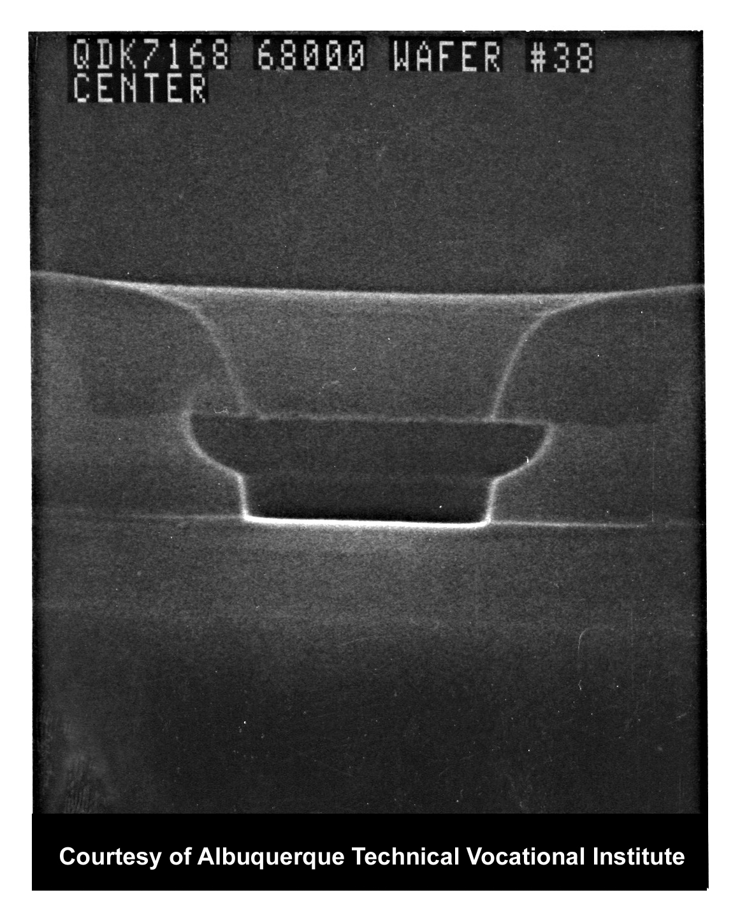
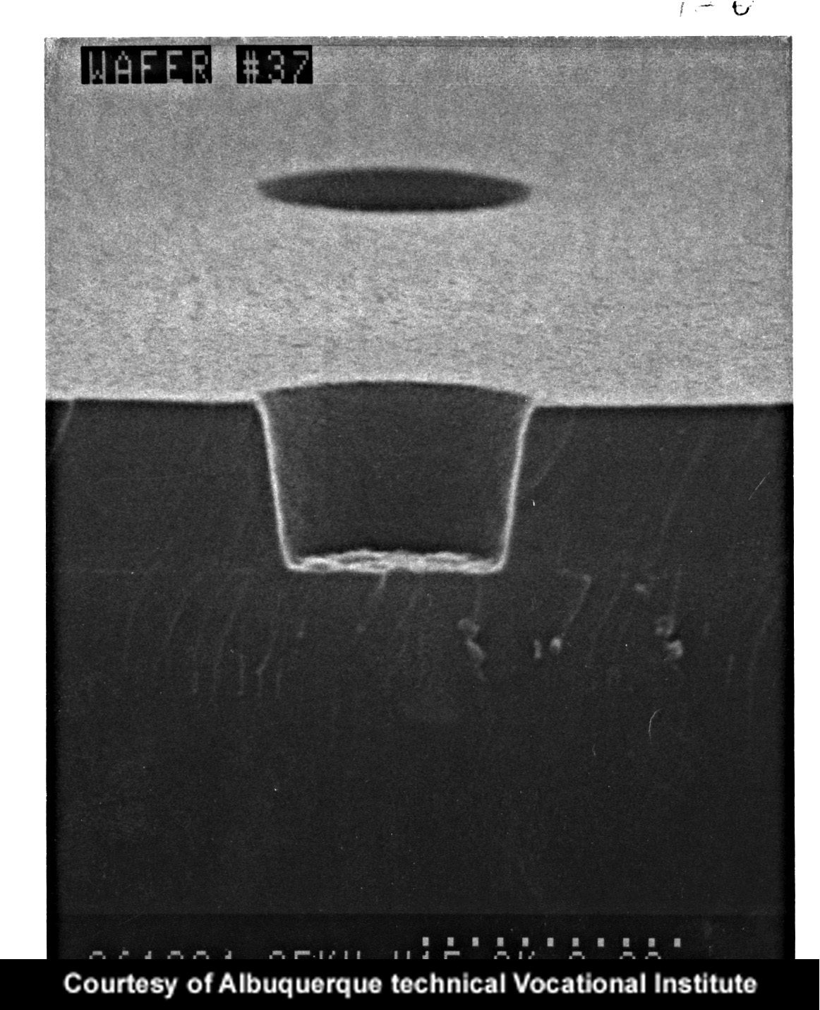
Etch Profiles
Isotropic Etch Profile
Anisotropic Etch Profile
Notes:
The isotropic etch profile on the left shows that etching of the sidewalls has occurred at a similar rate to the vertical etch. The round undercut shown is commonly found in wet etching. This can actually be used to advantage in creating some features, such as aluminum contacts. The anisotropic etch profile on the right shows that the sidewalls of the feature are nearly vertical or perpendicular to the plane.

Slide 9
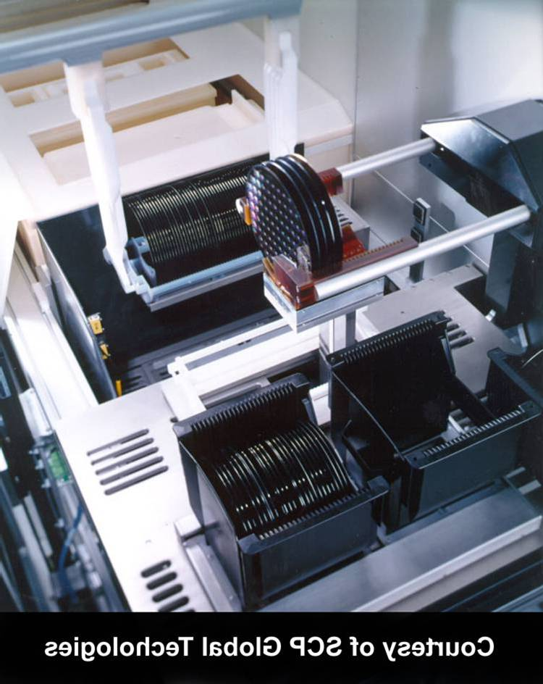
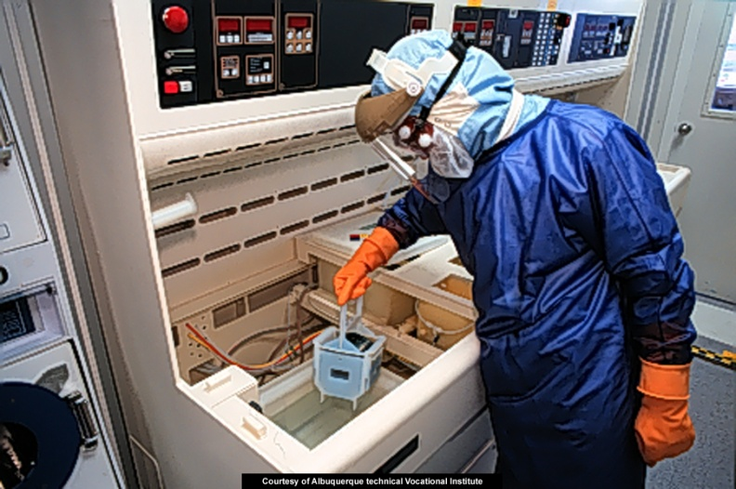
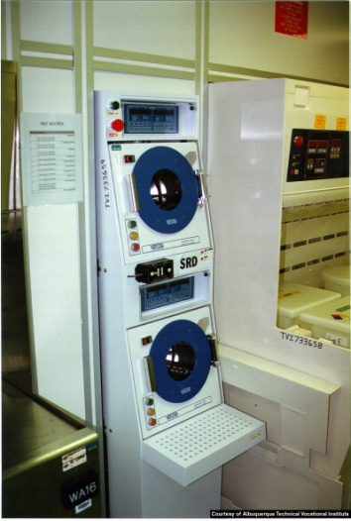
Wet Etch Process Steps
Notes:
In the photo on the left, wafers are being loaded into the wet etch tank. After etching, the techician places the boat in a rinse solution, shown on the upper right, followed by a drying process shown at the lower right.

Slide 10
Wet Etch (3)
Wet Etch processes can be batch processes where multiple wafers are etched at one time
Many wet etch processes are limited to features sizes of 3uM or larger, limiting their use in nanomanufacturing to bulk processes
Wet etch can be used to remove sacrificial layers present in MEMS devices
Notes:
Generally speaking, wet etch processes today find little application in feature definition, but are useful for bulk operations. Practical dimensional limits of feature sizes 3uM and larger due to isotropic etching with this process limits its usefulness for many applications. Removal of the sacrificial layer below a MEMs device often entails etching away a larger area of material. Wet etch is sometimes used for this purpose.

Slide 11
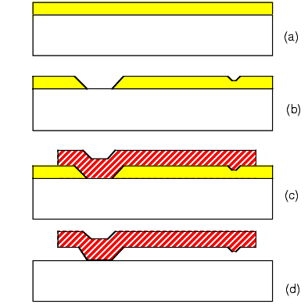
Creation and etch of Sacrificial Layer
(a) Sacrificial Layer deposition
(b) Patterning of layer
(c) Metal Deposition
(d) Etch of sacrificial layer to free feature
© The Aerospace Corp, 1996 - 2004
http://www.aero.org/publications/helvajian/helvajian-2.html
Notes:
In MEMS devices, such as the cantilever shown above, a sacrificial layer is deposited above the substrate. After patterned by photolithography and etching as shown in (b), a metal layer is grown over the layer. Wet etching can be used to remove the sacrificial layer. Now, the metal layer is affixed on one side but can flex on one side.

Slide 12
Dry Etch Methods
Dry Etching can be a physical or chemical process
  Ion Beam Etch - a physical etch process
  Gaseous chemical etch
  Plasma enhanced etch
  Reactive Ion Etch
  Deep Reactive Ion Etch
Notes:
Dry etching methods are largely replacing wet etch in nanofabrication. The advantages of dry etch processes include anisotropic etch profiles in some cases, and the possibility of high aspect ratios for features on a device (depth .vs. width). Dry etching processes can include purely physical etching, chemical etching, or combinations of both. Each will be discussed separately.

Slide 13
Physical Dry Etch
Sputtering (Ion Milling or Ion Beam Etch)
  Reduced pressure environment (<50 mTorr)
    Increases mean free path between molecules
      Fewer collisions between molecules
  Inert gas injected at low pressure is used as “milling” tool
  RF Plasma in chamber
    Energy transfer to gas molecules creates a plasma of equal numbers of ions and molecules
    Positive Ions bombard negatively charged target (wafer), removing molecules from the surface
Notes:
In sputtering, air molecules are removed from the chamber and a low pressure inert gas, such as argon, is injected. An RF plasma is created at low pressure, which creates an environment where the mean free path between the gas atoms is large. Normally, atoms would frequently collide, but in this environment, there are few remaining. The RF energy from the plasma acts on the Argon atoms. At the correct low pressure level, a single electron can impact an orbiting electron in an Argon atom, knocking it out of orbit. This creates an ion (positively charged) and a free electron that can be accelerated into another atom. A small percentage (much less than 1% typically) of the atoms are ionized. Some electrons are not knocked out of orbit by the electron that strikes the atom, but are excited to a higher energy level. As they drop back to the lower level, they give off the energy in the form of light, indicated by the characteristic plasma glow.

Slide 14
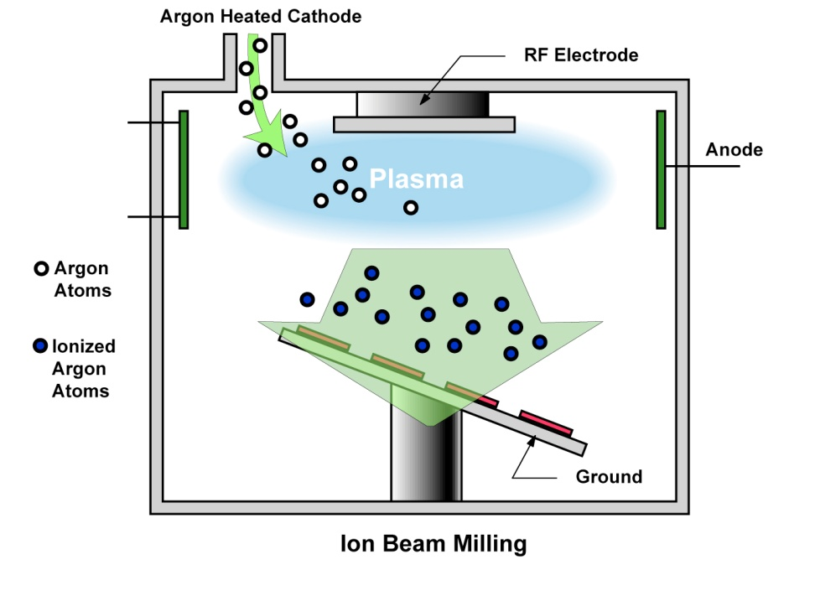
Ion Milling (cont’d)
Plasma etch has low selectivity
Plasma etch tends to be anisotropic
High RF levels can cause damage to the wafer
Less common today
Notes:
The ion milling process is purely a physical process that uses large amounts of RF power and suffers from a lack of selectivity compared to other processes. Although it is anisotropic and will have minimal undercutting, there are other more effective processes.

Slide 15
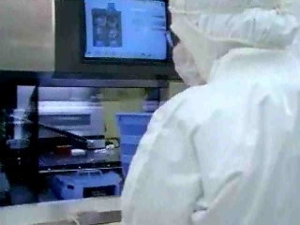
Remote Plasma Etch
Gaseous species entering chamber pass by an externally generated RF Field
This causes the generation of free radicals that are highly reactive and speeds up the chemical etch process
From MATEC Module 47
Notes:
Remote plasma (outside the reaction chamber) causes the gases to disassociate into ions and free radicals. The free radicals are highly reactive and pass into the chamber where they react with the surface to be etched. Although this increases the reaction rate, it does not improve the isotropic properties of the process.

Slide 16
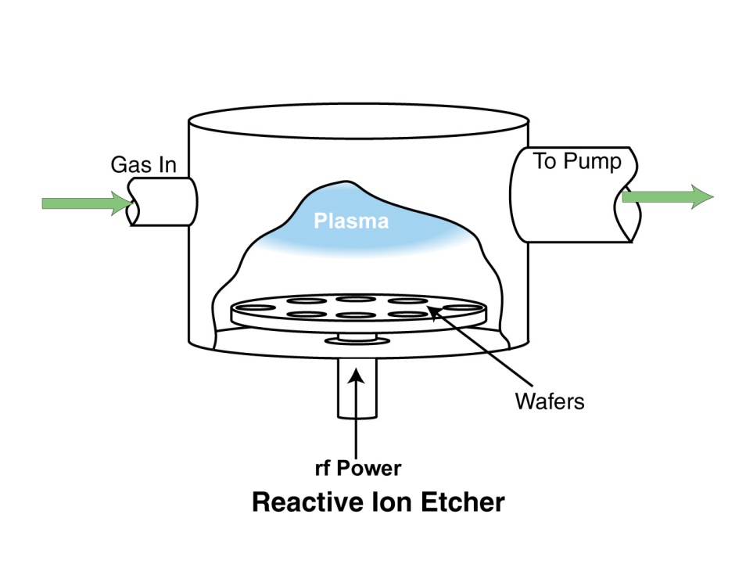
Reactive Ion Etch
In RIE, a combination of physical and chemical etching occurs.
In this case, both Ar and the chemical gas are used
Ar performs an ion milling physical etch and the chemical etch proceeds as well.
Notes:
Reactive Ion Etching combines both a physical and chemical etch process. Argon is used in a plasma as a physical etching process. The anisotropy of this process is retained, and the physical removal process causes the surface to continually be exposed to the chemical etching taking place from the radicals in the gas that have been formed from the plasma. The name reactive ion etching is something of a misnomer, as the ions in the etch are usually from an inert gas such as argon, and are not reactive. Ion assisted etching is a more accurate name for this process as the ion milling that occurs aids the chemical reaction.

Slide 17
Reactive Ion Etch (2)
RIE has the advantages of the physical ion milling etching and those of the dry chemical etch
  Anisotropic Profile
  Higher Etch Rate than either process
  Higher selectivity ratio than physical etch
  Smaller feature sizes possible
RIE has become the process of choice
Notes:
Reactive ion etching combines the anisotropic properties of the ion milling process with the increased speed of plasma enhanced chemical etching. The higher selectivity ratio of the chemical etch process is preserved in RIE, and small feature sizes can be defined. Reactive Ion Etching has become the process of choice in semiconductor processing, but additional requirements for nanostructures and deep trench features in semiconductor processing for capacitors in DRAMs demand other processes.

Slide 18
Deep Reactive Ion Etch
High Aspect ratio features (narrow, tall) require vertical sidewalls
Bosch DRIE process uses alternative etch and passivation technique to etch vertically and protect sidewalls with passivation coating
Cryrogenic process uses low temperatures and simultaneously passivates and etches
Notes:
Tall features, such as comb-like structures found in RF-MEMS, filters, and other devices require processing techniques that will retain vertical sidewalls. The Bosch DRIE process accomplishes this by alternating etch steps with passivation coatings that are deposited on the sidewalls. The sidewall features may not be entirely flat, and may have a slight sawtooth structure, but undercutting is eliminated. In the cryrogenic process, both etch and passivation take place at the same time, but at temperatures near -110 degrees C. Smoother sidewalls and higher selectivity are advantages of this process, but more environmental control is required. By comparison, feature heights of well over 100uM can be realized with DRIE as opposed to 10uM or less with RIE.

Slide 19
Dry Etch Parameters (1)
Factors Influencing Dry Etch Process
Etch rate
- RF Power level
- Gas formula
- Etch Temperature
Pressure
- Extremely high pressure results in an isotropic etch
- Low pressure with high energy can damage wafer
Slide directly taken from MATEC Module 47
Notes:
Etch Rate. The etch rate during a plasma etch is determined by system design, pressure and chemical species density. Because there is a direct correlation between power level and gas dissociation, higher power levels produce more ions and radicals. This in turn increases the rate of etch. The etch rate also can be influenced by the gas formula. Finally, the dry etch temperature influences the etch rate. Increasing temperature increases the etch rate. However, at temperatures exceeding 200ºC, the photoresist can bake, which will eventually render it difficult to remove from the wafer. Pressure. Pressure levels also can influence the etch profile. If the pressure in the vacuum chamber is too high, particles begin to collide with each other and travel off in many directions. This results in an isotropic etch. In the pressure range of 0.4-50.0 mTorr, particle collisions can be kept to a minimum and anisotropic profiles can be achieved. However, low pressure and high energy in the vacuum chamber can cause plasma radiation damage to the wafer. The resulting damage includes surface leakage, changes in electrical parameters, degradation of the film on the wafer and overexposure. It may also harden the photoresist, making it difficult to remove. (Notes from MATEC MODULE 47)

Slide 20
Dry Etch Parameters (2)
Factors Influencing Dry Etch Process
Micro-loading
- Different etch rates across wafer surface
- Ashing can occur
Post-etch corrosion
- Due to residual etchant left on wafer after final rinse
- Using a non- chlorine based etchant like Fluorine.eliminates the problem.
Taken directly from MATEC Module 47
Notes:
Micro-loading is a problem that can affect selectivity during the dry etch process. It occurs when the larger surface areas on the wafer etch at a slower rate than do smaller areas. As the larger areas etch, an abundance of by-product is produced. In turn, the amassed by-product slows down the etch rate. On the other hand, smaller areas are not affected by a buildup of by-product. Thus, the smaller areas etch faster than do the larger areas. In turn, the smaller areas are exposed to the chemical etchant for a longer period of time. This decreases selectivity in that region and promotes "ashing". Ashing occurs when the etch process removes the resist.
Post-etch corrosion. Another problem that can arise with dry etch is post-etch corrosion. Post-etch corrosion occurs when residue from the etchant is left on the wafer surface after the final rinse. Often, this is a result of Chlorine (Cl) reacting with metals on the wafer surface. Using a fluorine-based gas mixture instead of a Chlorine-based gas mixture can eliminate this problem.
Taken directly from MATEC MODULE 47

Slide 21
Post-Etch Process
Resist Stripping
Removes residual resist after etch process
Wet stripping
- For use on wafers that have not been plasma …. …..etched
- For non-metallic surfaces an acid solvent is used
- For metallic surfaces an organic solvent is used
Plasma Stripping
- For use on wafers that have been etched by plasma
- Uses oxygen as stripping plasma to remove …..photoresist
Taken Directly From MATEC Module 47
Notes:
After the pattern has been transferred onto the wafer surface layer and the etching is complete, the resist layer is no longer needed. Typically, residual resist remains. This is removed from the wafer by either a wet or plasma stripping process, depending upon the type of wafer surface, polarity of the resist, condition of the resist, as well as other production considerations. The striping process selected also must be able to overcome the problems created by prior etching, high temperature bakes, plasma etch residue, sidewall polymers and ion implantation crusting.
Taken directly from MATEC MODULE 47

